Slide 1


Akshay M
2 Feb 2023

Slide 2

Outline
Executive Summary
Introduction
Methodology
Results
Conclusion
Appendix

Slide 3
Executive Summary
Summary of methodologies
Data collection
Data wrangling
Exploratory Data Analysis with Data Visualization
Exploratory Data Analysis with SQL
Building an interactive map with Folium
Building a Dashboard with Plotly Dash
Predictive analysis (Classification)
Summary of all results
Exploratory Data Analysis results
Interactive analytics demo
Predictive analysis results

Slide 4
Introduction
Project background and context
SpaceX company advertises Falcon 9 rocket launches on its website, with a cost of 62 million dollars; other providers cost upward of 165 million dollars each, much of the savings is based on whether SpaceX can reuse the first stage. Hence the importance of the reuse of the first stage is paramount. This is a major factor in determining the cost of the launch.
Questions to be answered
What are the factors that determine the success of a launch?
How do factors (payload mass, number of flights, launch site and orbits affect the success?
Which algorithm will provide the best accuracy of prediction?

Slide 5

Section 1

Slide 6
Methodology
Executive Summary
Data collection methodology:
Using Spacex REST API
Web scrapping from Wikipedia
Perform data wrangling
Cleaning of null values and irrelevant columns
Perform exploratory data analysis (EDA) using visualization and SQL
Perform interactive visual analytics using Folium and Plotly Dash
Perform predictive analysis using classification models
DT, SVM, KNN and LR models have been built and evaluated to find out the best performing classifier

Slide 7
Data Collection
Data Sources
SpaceX REST API endpoint was used to fetch the launch data
Web scraping using Beautiful Soup
Data Wrangling
The data was consolidated and cleaned
Fetch launch data using REST API
Fetch HTML & process using BeautifulSoup
Normalise the JSON data into CSV format
Normalise the data into CSV format
Consolidate & clean the data

Slide 8
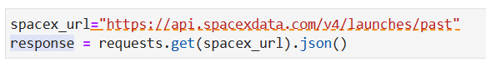
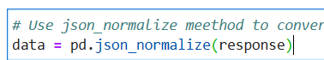
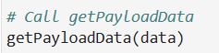
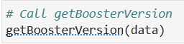
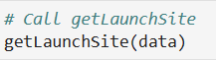
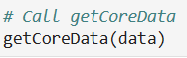
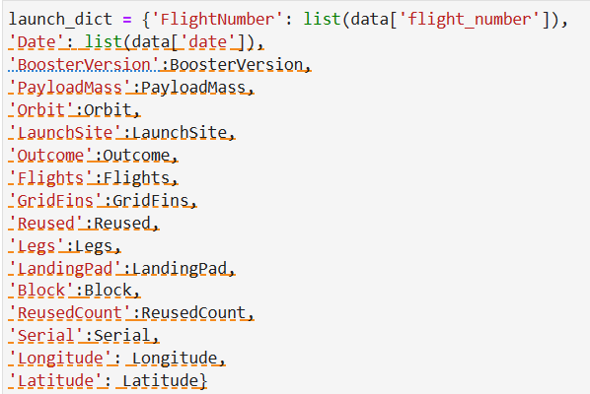
Data Collection – SpaceX API
Fetch response, convert to JSON
Normalize to Data Frame
Call functions to extract info
Make dictionary out of list
Convert dictionary to Data Frame
Filter out records
Create CSV file
URL : https://github.com/akshayravim/courserarepo/blob/1f8bb603244639d801ce83119aa43ff3f3598274/jupyter-labs-spacex-data-collection-api.ipynb

Slide 9
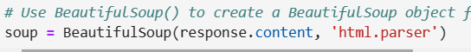
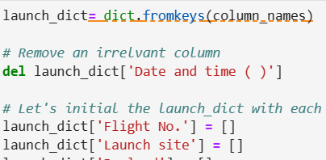
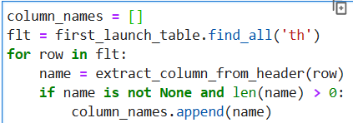
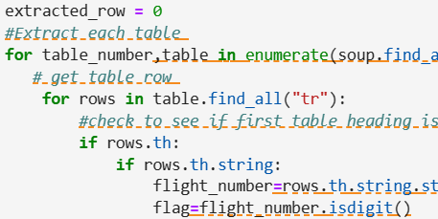
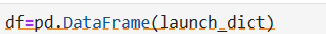
Data Collection - Scraping
Fetch the HTML response
Parse contents using BeautifulSoup
Find all tables
a. Iterate & find names
b. Create dictionary
5. Populate column names
6. Create Data frame from dictionary
7. Write CSV file of the Data Frame data
URL: https://github.com/akshayravim/courserarepo/blob/d330bf395085e1824f1edbc527c0b6ddfb7c3b5e/jupyter-labs-webscraping.ipynb

Slide 10
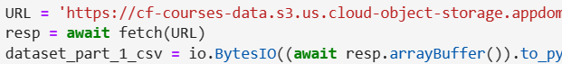
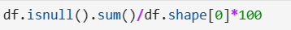
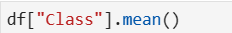
Data Wrangling
Fetch the CSV file
Calculate the percentage of the missing values
Determine the number of launches on each site and the number and occurrence of each orbit in the column Orbit
Determine the number of landing outcomes
Create a set of outcomes where the second stage did not land successfully
Create a list where the element is zero or one based on the outcome
Determine the success rate
Export it to a CSV
URL: https://github.com/akshayravim/courserarepo/blob/4136eaba27cc53260faf9700e9b32dad496e46ef/IBM-DS0321EN-SkillsNetwork_labs_module_1_L3_labs-jupyter-spacex-data_wrangling_jupyterlite.jupyterlite.ipynb

Slide 11
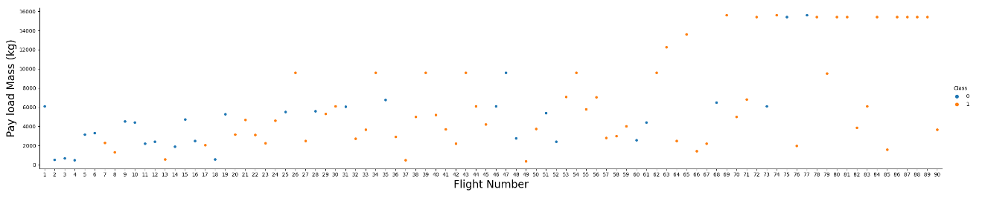
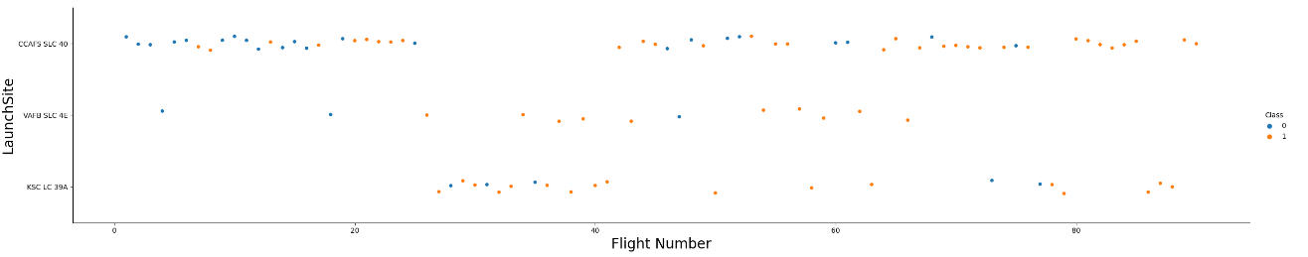
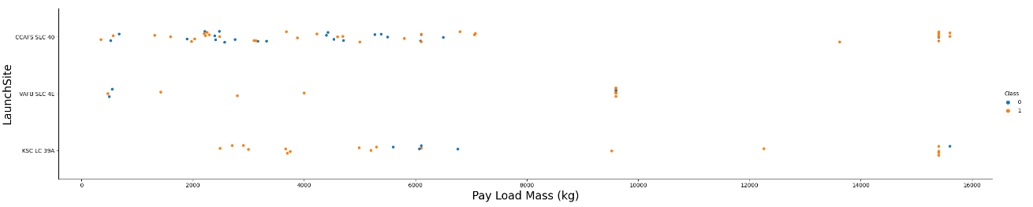
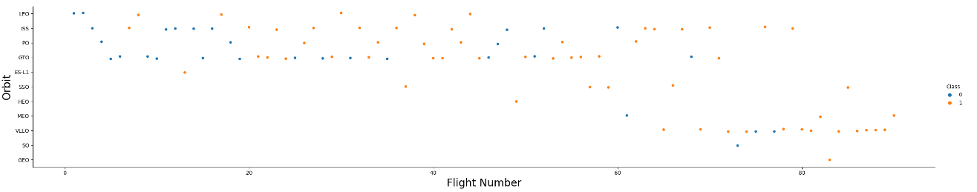
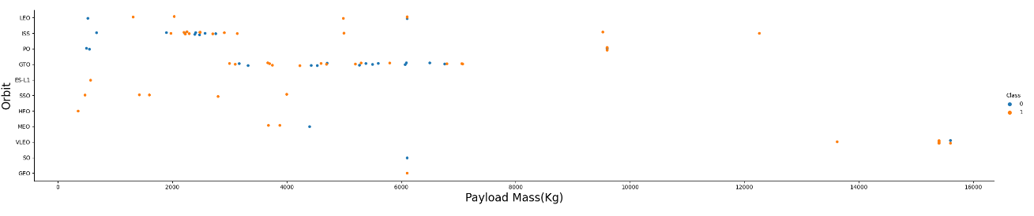
EDA with Data Visualization
Aim is to visualize the relationship between Payload Mass, Flight Number, Flight Number, Launch Site and Orbit type features

Slide 12
EDA with SQL
SQL queries performed include:
Display the names of the unique launch sites in the space mission
Display 5 records where launch sites begin with the string 'CCA'
Display the total payload mass carried by boosters launched by NASA (CRS)
Display average payload mass carried by booster version F9 v1.1
List the date when the first successful landing outcome in ground pad was achieved.
List the names of the boosters which have success in drone ship and have payload mass greater than 4000 but less than 6000
List the total number of successful and failure mission outcomes
List the names of the booster_versions which have carried the maximum payload mass. Use a subquery
List the records which will display the month names, failure landing_outcomes in drone ship ,booster versions, launch_site for the months in year 2015.
Rank the count of successful landing_outcomes between the date 04-06-2010 and 20-03-2017 in descending order.
https://github.com/akshayravim/courserarepo/blob/62190067c0634e2e066541386a304fb737d6434f/jupyter-labs-eda-sql-coursera_sqllite.ipynb

Slide 13
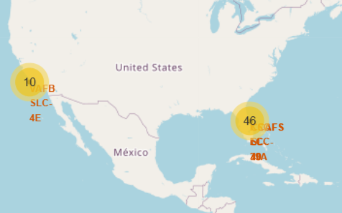
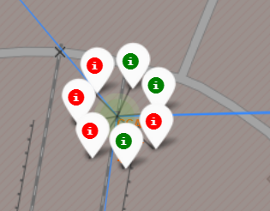
Build an Interactive Map with Folium
Circles with numbers were used to depict the number of launches
Lines were drawn to show and help calculate the distance between the launch sites and the railways, highways etc.
Red markers were used to indicate failed launches
Green markers were used to indicate successful launches
URL:
https://github.com/akshayravim/courserarepo/blob/6e54a15509c62f8c9f9257ebdc3e1ecad938a840/IBM-DS0321EN-SkillsNetwork_labs_module_3_lab_jupyter_launch_site_location.jupyterlite.ipynb

Slide 14
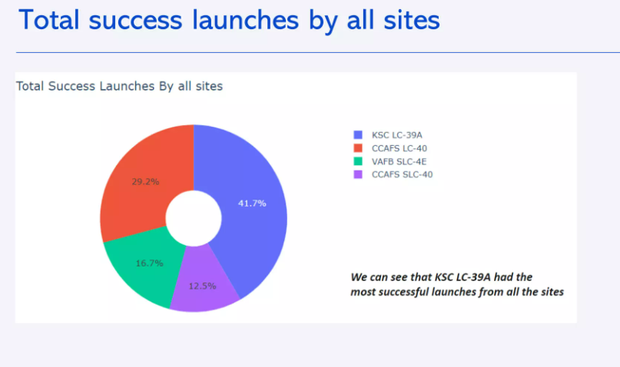
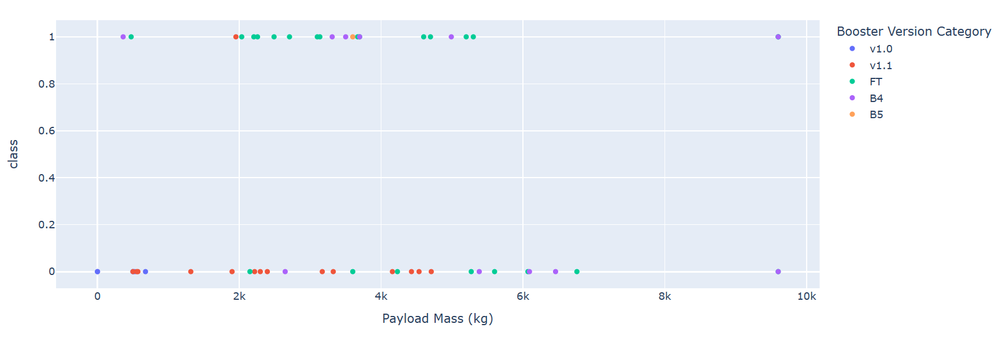
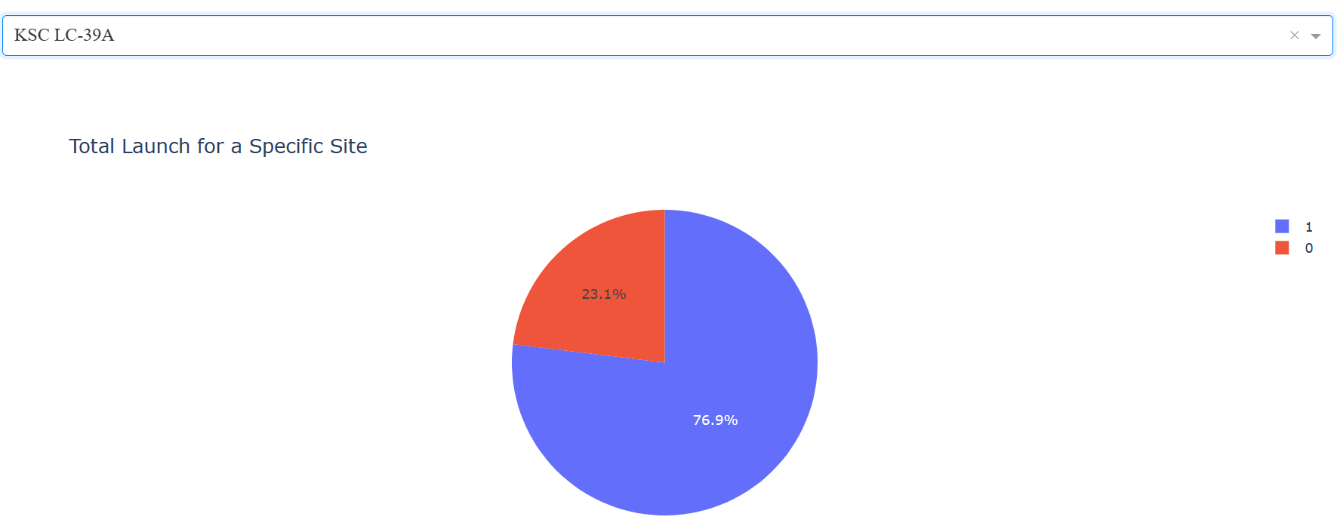
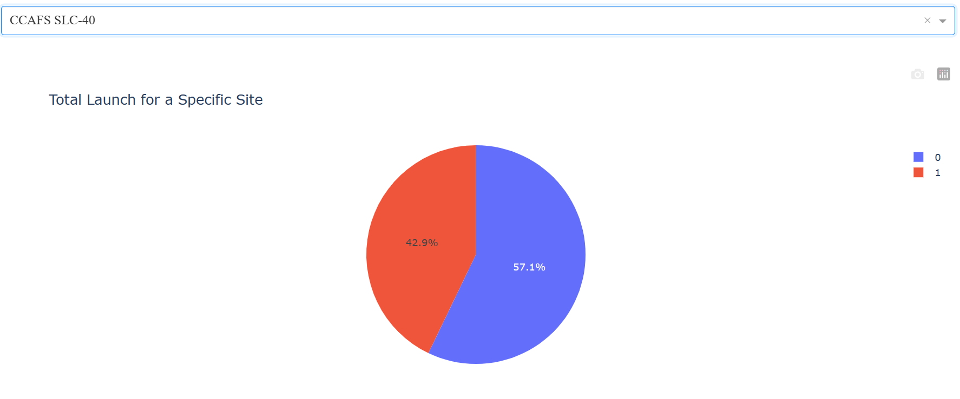
Build a Dashboard with Plotly Dash
To display the successful launches from the various sites
To visualize the correlation between the payload mass and the success or failure
In order to identify the launch sites with the highest and lowest launch success rates

Slide 15
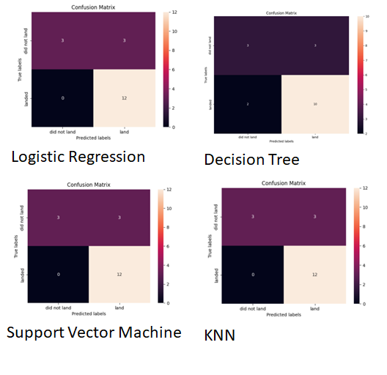
Predictive Analysis (Classification)
Logistic Regression, SVM and KNN achieved 83.33% accuracy, while Decision Tree achieved 72%
https://github.com/akshayravim/courserarepo/blob/60f6585156dccfecbfcb6f44cea151dd7b3dd457/IBM-DS0321EN-SkillsNetwork_labs_module_4_SpaceX_Machine_Learning_Prediction_Part_5.jupyterlite%20(1).ipynb

Slide 16
Results
KSC LC-39A launch site had the most successful launches when compared to other sites
Among the algorithms, Logistic Regression, KNN and SVM had the highest accuracy
The Orbits VLEO, SSO, HEO, ESL-1 had the most success rates
Heavier payloads have failed in comparison to lighter payloads
Most of the launch sites are in proximity to the equator and the coast lines.
Lastly, probably due to technological advances and/or learning from mistakes the launch success rates have been increasing over the years.

Slide 17

Section 2

Slide 18
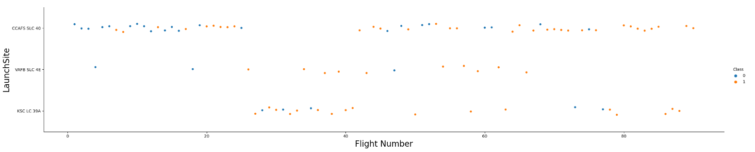
Flight Number vs. Launch Site
Insight:
Launches from the CCAFS SLC 40 are higher than launches from other sites.
URL:
https://github.com/akshayravim/courserarepo/blob/83e8712a8f45a5e0dff286a5d9b737b0a7bbb611/IBM-DS0321EN-SkillsNetwork_labs_module_2_jupyter-labs-eda-dataviz.ipynb.jupyterlite.ipynb

Slide 19
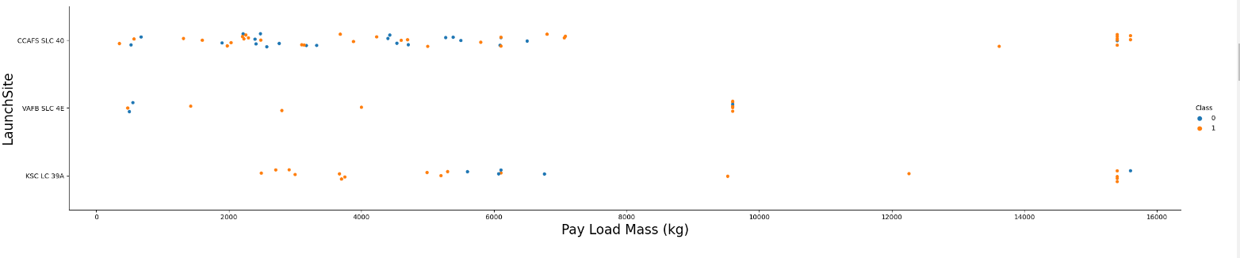
Payload vs. Launch Site
Insight:
Majority of the launches from the CCAFS SLC 40 have had lower pay load mass.
The CCAFS SLC 40 has launched the lowest to the highest pay load masses.
URL:
https://github.com/akshayravim/courserarepo/blob/83e8712a8f45a5e0dff286a5d9b737b0a7bbb611/IBM-DS0321EN-SkillsNetwork_labs_module_2_jupyter-labs-eda-dataviz.ipynb.jupyterlite.ipynb

Slide 20
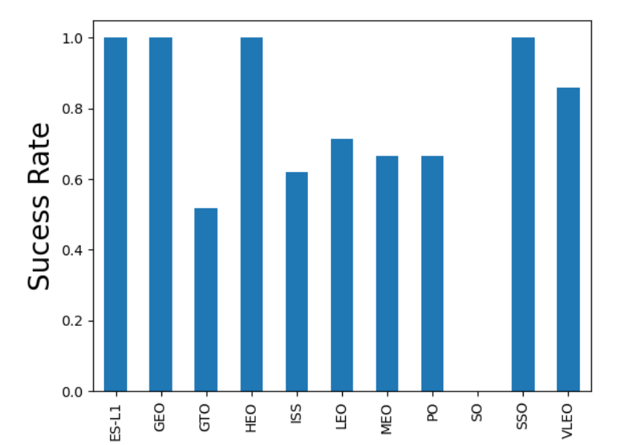
Success Rate vs. Orbit Type
Insight:
Orbit type of ES-L1, GEO, HEO, SSO have the highest success rates
URL:
https://github.com/akshayravim/courserarepo/blob/83e8712a8f45a5e0dff286a5d9b737b0a7bbb611/IBM-DS0321EN-SkillsNetwork_labs_module_2_jupyter-labs-eda-dataviz.ipynb.jupyterlite.ipynb

Slide 21
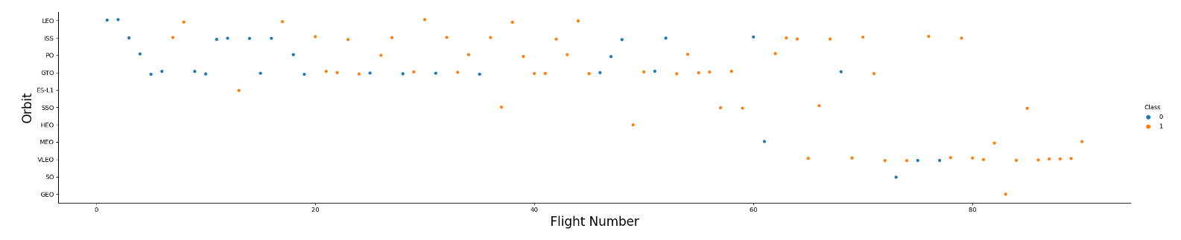
Flight Number vs. Orbit Type
Insight:
For the latest flight number(s), VLEO launches have been used. Appears that the trend is shifting to VLEO for the newer launches.
URL:
https://github.com/akshayravim/courserarepo/blob/83e8712a8f45a5e0dff286a5d9b737b0a7bbb611/IBM-DS0321EN-SkillsNetwork_labs_module_2_jupyter-labs-eda-dataviz.ipynb.jupyterlite.ipynb

Slide 22
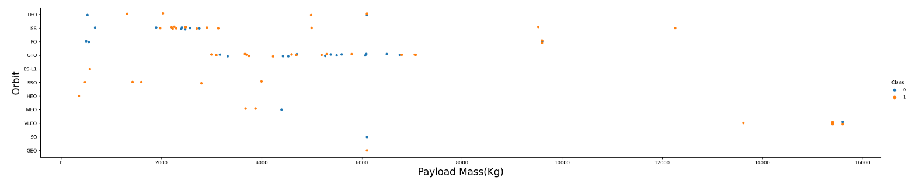
Payload vs. Orbit Type
Insight:
Around 2000 payload mass (kg) for ISS and in the range of 4000 to 8000 payload mass (kg) there appears to correlation.
URL:
https://github.com/akshayravim/courserarepo/blob/83e8712a8f45a5e0dff286a5d9b737b0a7bbb611/IBM-DS0321EN-SkillsNetwork_labs_module_2_jupyter-labs-eda-dataviz.ipynb.jupyterlite.ipynb

Slide 23
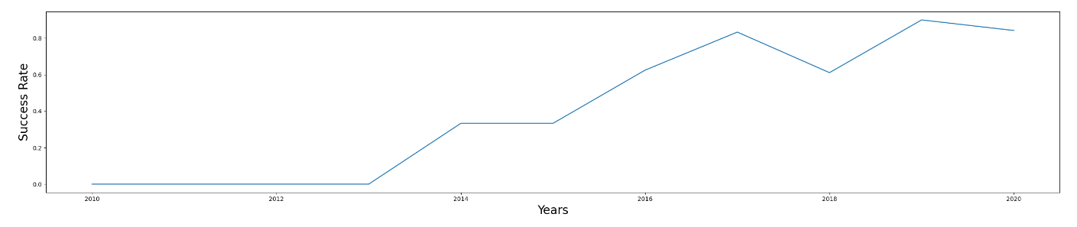
Launch Success Yearly Trend
Insight:
Launch success rates has been increasing since 2013 possibly due to technology advances.
URL:
https://github.com/akshayravim/courserarepo/blob/83e8712a8f45a5e0dff286a5d9b737b0a7bbb611/IBM-DS0321EN-SkillsNetwork_labs_module_2_jupyter-labs-eda-dataviz.ipynb.jupyterlite.ipynb

Slide 24
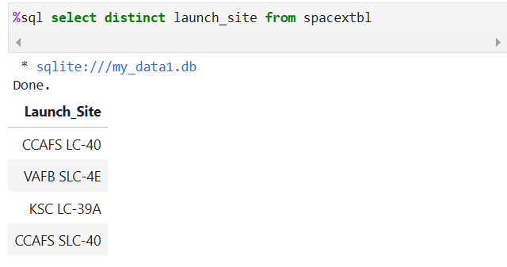
All Launch Site Names
Explanation:
Fetches the unique (distinct) launch sites from the table
URL:
https://github.com/akshayravim/courserarepo/blob/62190067c0634e2e066541386a304fb737d6434f/jupyter-labs-eda-sql-coursera_sqllite.ipynb

Slide 25
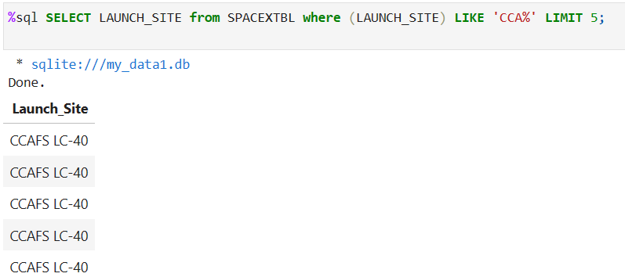
Launch Site Names Begin with 'CCA'
Explanation:
Fetches the launch sites from the table where the site names begin with ‘CCA’
URL:
https://github.com/akshayravim/courserarepo/blob/62190067c0634e2e066541386a304fb737d6434f/jupyter-labs-eda-sql-coursera_sqllite.ipynb

Slide 26
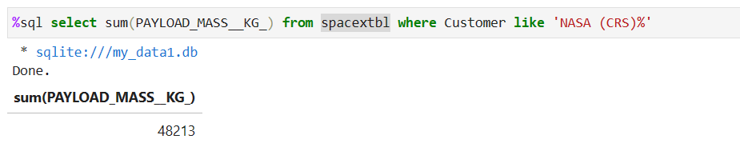
Total Payload Mass
Explanation:
Displays the total payload mass carried by boosters launched by NASA (CRS)
URL:
https://github.com/akshayravim/courserarepo/blob/62190067c0634e2e066541386a304fb737d6434f/jupyter-labs-eda-sql-coursera_sqllite.ipynb

Slide 27
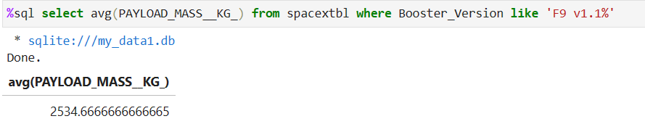
Average Payload Mass by F9 v1.1
Explanation:
Displays the average payload mass carried by booster version F9 v1.1
URL:
https://github.com/akshayravim/courserarepo/blob/62190067c0634e2e066541386a304fb737d6434f/jupyter-labs-eda-sql-coursera_sqllite.ipynb

Slide 28
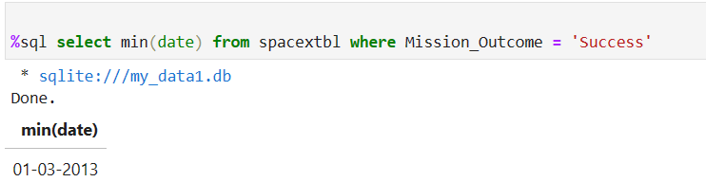
First Successful Ground Landing Date
Explanation:
Lists the date when the first successful landing outcome in ground pad was achieved.
URL:
https://github.com/akshayravim/courserarepo/blob/62190067c0634e2e066541386a304fb737d6434f/jupyter-labs-eda-sql-coursera_sqllite.ipynb

Slide 29
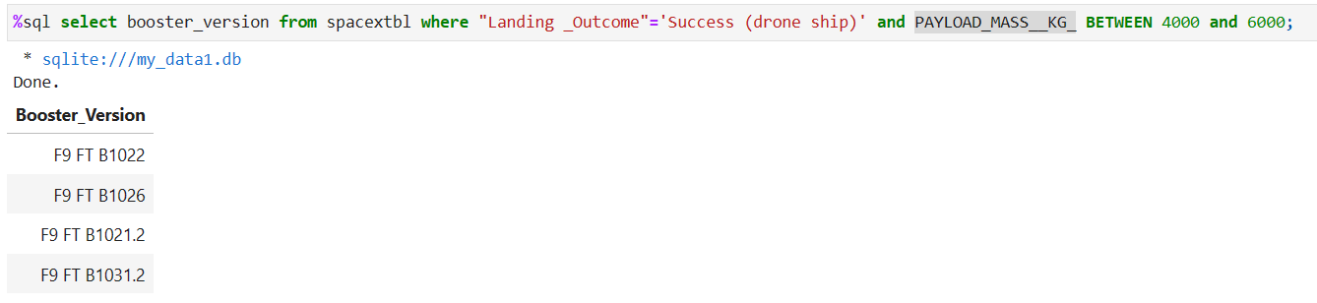
Successful Drone Ship Landing with Payload between 4000 and 6000
Explanation:
Lists the names of the boosters which have success in drone ship and have payload mass greater than 4000 but less than 6000e
URL:
https://github.com/akshayravim/courserarepo/blob/62190067c0634e2e066541386a304fb737d6434f/jupyter-labs-eda-sql-coursera_sqllite.ipynb

Slide 30
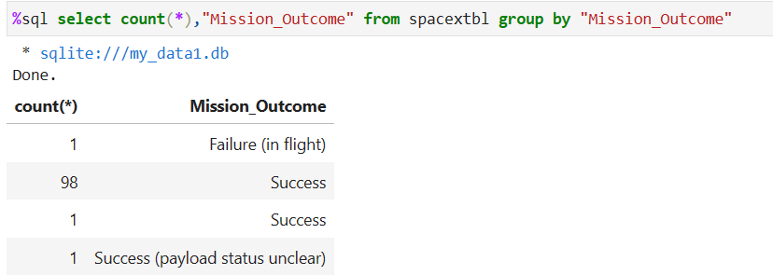
Total Number of Successful and Failure Mission Outcomes
Explanation:
Lists the total number of successful and failure mission outcomes
URL:
https://github.com/akshayravim/courserarepo/blob/62190067c0634e2e066541386a304fb737d6434f/jupyter-labs-eda-sql-coursera_sqllite.ipynb

Slide 31
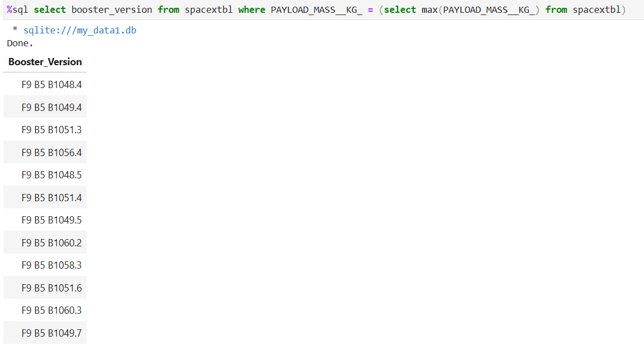
Boosters Carried Maximum Payload
URL:
https://github.com/akshayravim/courserarepo/blob/62190067c0634e2e066541386a304fb737d6434f/jupyter-labs-eda-sql-coursera_sqllite.ipynb
Explanation:
Lists the names of the booster versions which have carried the maximum payload mass.

Slide 32
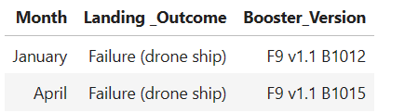
2015 Launch Records
%sql select case substr(Date,4,2) when '01' then 'January' when '02' then 'Febuary' when '03' then 'March' when '04' then 'April' when '05' then 'May' when '06' then 'June' when '07' then 'July' when '08' then 'August' when '09' then 'September' when '10' then 'October' when '11' then 'November' when '12' then 'December' else '' end as Month, "Landing _Outcome", Booster_version from spacextbl where "Landing _Outcome" like 'Failure (drone ship)' and substr(Date,7,4)='2015'
Explanation:
List the records which will display the month names, failure landing outcomes in drone ship ,booster versions, launch site for the months in year 2015.
URL:
https://github.com/akshayravim/courserarepo/blob/62190067c0634e2e066541386a304fb737d6434f/jupyter-labs-eda-sql-coursera_sqllite.ipynb

Slide 33
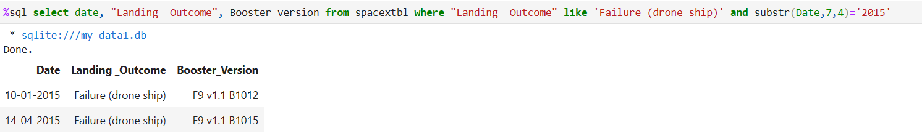
Rank Landing Outcomes Between 2010-06-04 and 2017-03-20
Explanation:
Ranked count of successful landing outcomes between the date 04-06-2010 and 20-03-2017 in descending order.
URL:
https://github.com/akshayravim/courserarepo/blob/62190067c0634e2e066541386a304fb737d6434f/jupyter-labs-eda-sql-coursera_sqllite.ipynb

Slide 34

Section 3

Slide 35
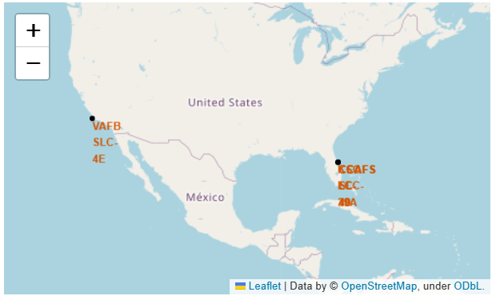
All site marked on the map
Findings:
All the launch sites are in proximity to the Equator line.
All the launch sites are in proximity to the coast.
Explanation:
This makes sense as it takes less fuel to escape the earth's gravity to get into space into space from the equator due Earth's rotation, and secondly for safety reasons the launch sites are closer to the coast.

Slide 36
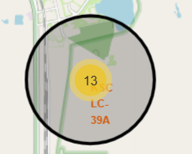
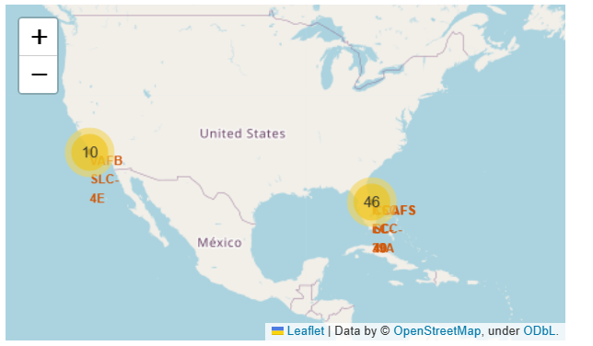
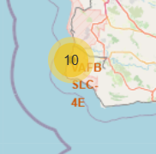
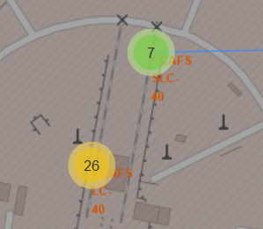
Successful outcomes marked on map
Outcomes marked on the map
East coast sites
West coast site

Slide 37
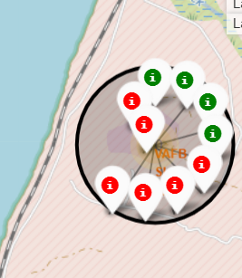
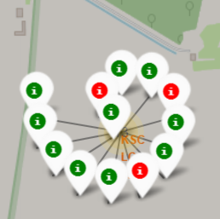


Launch sites with color labels
VAFB SLC-4E
KSC LC-39A
CCAFS SLC-40
CCAFS LC-40
Successful launches marked in Green
Failed launches marked in Red

Slide 38

Section 4

Slide 39
Total successful launches – all sites
KSC LC-39A has the most successful launches when compared to all other sites

Slide 40
Success rate by launch site
KSC LC-39A achieved the highest of 76.9% success rate while CCAFS SLC-40 has the lowest of 57.1% success rate

Slide 41
Payload mass vs Launch outcome
The low weighted(2K-5K) payloads have a higher success rate than the high weighted(7K-10K) payloads

Slide 42

Section 5

Slide 43


Classification Accuracy
Among the algorithms, Logistic Regression, KNN and SVM had the highest accuracy

Slide 44





Confusion Matrix
Decision Tree has the lowest accuracy in prediction among the other algorithms deployed.
Logistic Regression
Decision Tree
Support Vector Machine
KNN

Slide 45
Conclusions
KSC LC-39A launch site had the most successful launches when compared to other sites
Among the algorithms, Logistic Regression, KNN and SVM had the highest accuracy
The Orbits VLEO, SSO, HEO, ESL-1 had the most success rates
Heavier payloads have failed in comparison to lighter payloads
Most of the launch sites are in proximity to the equator and the coast lines.
Lastly, probably due to technological advances and/or learning from mistakes the launch success rates have been increasing over the years.

Slide 46


